Slide 1
Human Resource Business Project using Data Analytics
Presented by,
Amogh Sridhar.
1KS22SCS01
For the fulfillment of MTech Mini Project
Guide
Dr. Rekha B Venkatapur
Professor & Head,
Dept. of Computer Science and Engineering
KSIT, Bangalore

Slide 2
Table of Contents
Introduction
Literature review
Objectives of Work
Technology Used
Implementation
Results
Conclusion and Future Scope

Slide 3
Introduction:
Human Resource Management is the process of recruiting, selecting, inducting employees, providing orientation, imparting training and development, appraising the performance of employees and providing benefits, motivating employees, maintaining proper relations with employees.
The role of HRM practices are to manage the people within a workplace to achieve the organization’s mission and reinforce the culture.
When done effectively, HR managers can help recruit new professionals who have skills necessary to further the company’s goals as well as aid with the training and development of current employees to meet objectives

Slide 4
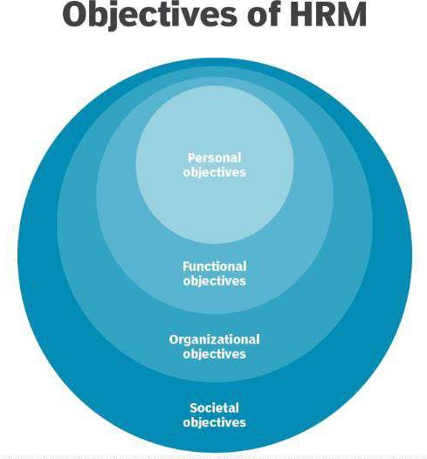
Objectives of Human Resource Management :
Societal objectives
Organizational objectives
Personal objectives
Functional objectives:

Slide 5
Literature Review:
Introduction : human resources are believed to be the most critical resources that organizations need in order to achieve their goals.
The Causes of the Great Resignation
The COVID-19 Pandemic
The Current Employee-Driven Labor Market
The Lack of Required Organizational Support for Employees
3. Strategies for Minimizing Employees Resignation
Providing Flexible Work Arrangements (FWAs)

Slide 6
Objectives of Work :
1. To, understand the reason behind employee resignation.
2. What type of employees are leaving?
3. Which employees are prone to leave next?
4. To understand the consequences of employee resignation.

Slide 7
Technology Used :
Data Analytics : Data analytics is the collection, transformation, and organization of data in order to draw conclusions, make predictions, and drive informed decision making.
Together, these four types of data analytics can help an organization make data-driven decisions. At a glance, each of them tells us the following:
Descriptive analytics tell us what happened.
Diagnostic analytics tell us why something happened.
Predictive analytics tell us what will likely happen in the future.
Prescriptive analytics tell us how to act.

Slide 8
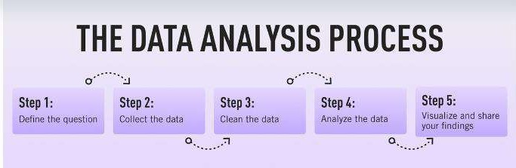
Tools and Techniques Used :
1. Data analytics :
2. Pearson correlation method: The Pearson product moment correlation coefficient can be described as a way to measure the strength of a linear relationship between two variables.
That is, Pearson correlation coefficient identifies whether:

Slide 9
There is a positive correlation between the two variables.(+1) That is, whether an increase in employee projects is associated with an increase in employee satisfaction.
There is a negative correlation between the two variables.(-1) More specifically, whether a rise in projects is associated with a reduction in employee satisfaction, or vice versa.
There is no relationship between the variables.(0) In other words, changes in employee projects and employee satisfaction are unrelated to one another.Insight into this relationship is a first step in understanding how variables of interest might relate to one another, and could also prompt further causal investigation
Correlation Coefficient | Analysis
0.0 to 0.1 | No correlation
0.1 to 0.3 | Low Correlation
0.3 to 0.5 | Medium Correlation
0.5 to 0.7 | High Correlation
0.7 to 1.0 | Very High Correlation
Table 4.1: Pearson Correlation Coeffcient Analysis

Slide 10
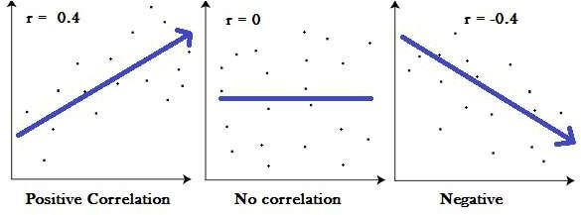
Fig :Pearson Correlation Comparison
3. Power Bi : Power BI is a business analytics solution that lets you visualize your data and share insights across your organization. Creating reports and dashboards that present data sets in multiple ways using visuals

Slide 11
Implementation: Implementation is the process of converting a new system design into an operational one. It is the key stage in achieving a successful new system.
Dataset : Here we have used two datasets. One containing the existing employees and the other containing the exiting employees. There are existing employees having data-columns like Employee ID, Satisfaction level (ranging from 0 to 1), Last Evaluation Score(ranging from 0 to 1), No of Projects at hand, Average Monthly Hours, Time Spent in Company(In Years), Work Accident(1 indicates they have committed an accident at work, 0 indicates they have not committed accident at work), Promotion Last 5 Years(0 indicates they haven’t got any promotion and 1 indicates they have got promotion), Department and Salary. Similarly we have exiting employees and having similar data-columns.
2. Data Inspection: It involves using the dataframe to extract the number of data-points(rows) and attributes(columns) in the two datasets. From Inspection, we have 11428 data-points in the Existing Employees dataset with 10 attributes. Similarly we have 3571 data points in the Exiting Employee dataset with 10 attributes
3. Data Cleaning : Data cleaning involves checking for null and empty values in any of the attributes and data points. If the dataset contains null values we fill those values with predefined values. After cleaning the data the dataset contains valid data in all the attributes and data points
4. Data Exploration : Metric used for data exploration is Pearson Correlation Coefficient. We begin by plotting a correlation heat-map.

Slide 12
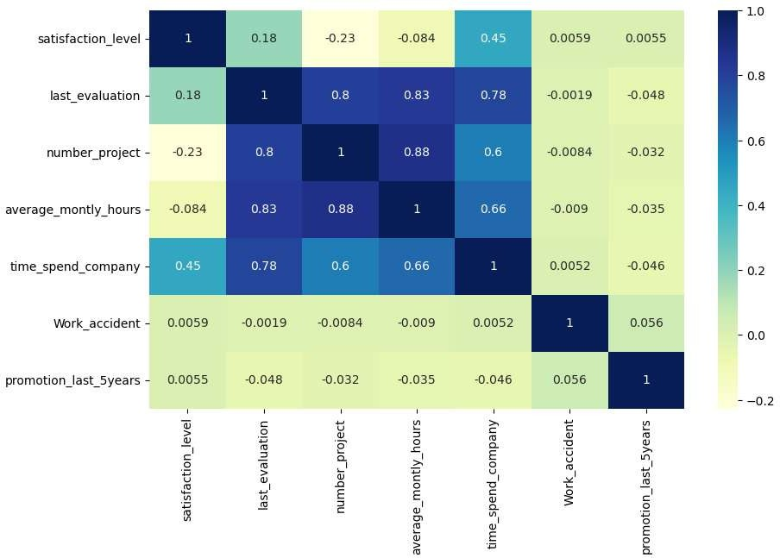

Slide 13
Medium Correlation of 0.45 exists between job satisfaction level and time spent in company, thus Satisfaction level increases or decreases as more time is spent in company.
Very High Correlation of 0.8 exists between last evaluation score and time spent in the company(0.78), average monthly hours(0.83) and number of projects(0.8). From this we can conclude that
The More longer you stay in the Company higher the last Evaluation Score
The Shorter you stay in the company, the lower is your last Evaluation Score
The More average monthly hours accrued, the higher is your last evaluation Score
The fewer average monthly hours accrued, the lower is your last evaluation Score
The more number of projects undertaken, indicates a higher last evaluation Score
The lesser number of projects undertaken, indicates a low last evaluation Score
Note : Probably the departing employees had less average monthly average hours, the number of projects and short stint in the company

Slide 14
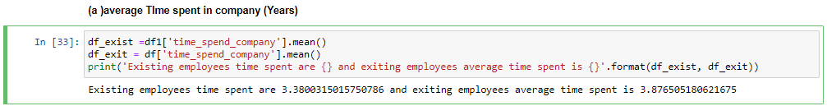
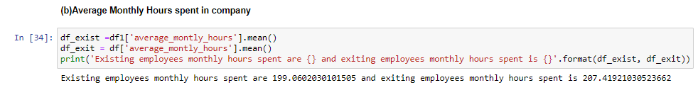
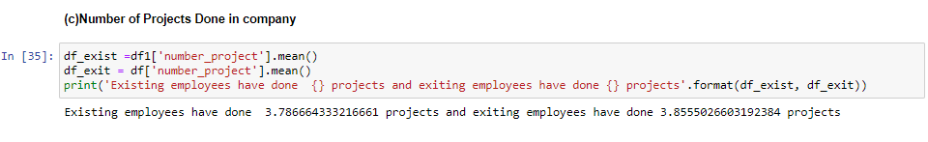

Slide 15
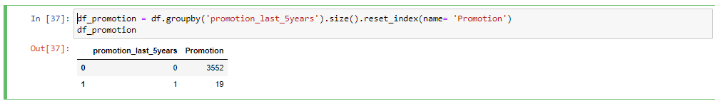
Only 19 out of 3571 Exiting employees have been promoted in the last 5 years. Report suggest that exiting employees have not been motivated to stay.

Slide 16
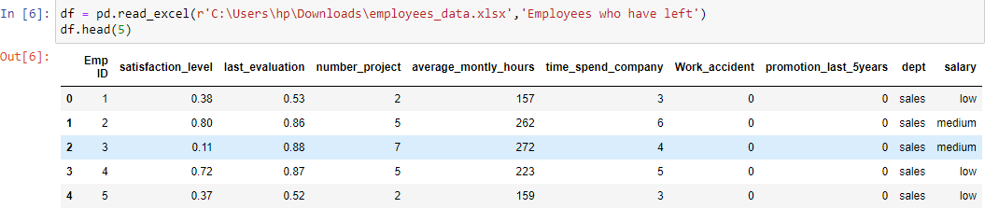
Results :
Read the excel worksheet of exiting employees and convert to data-frame using Python Pandas Library
Figure 5.1: Dataset of Exiting Employees

Slide 17
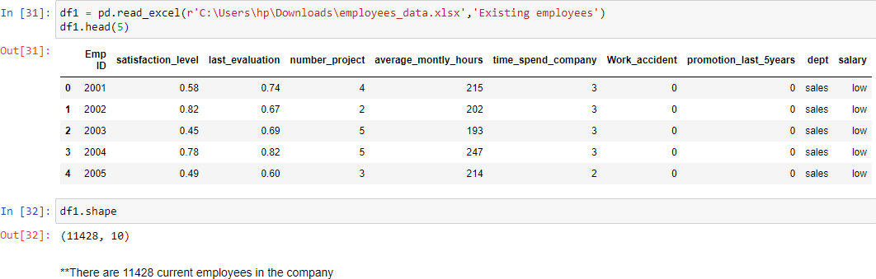
2. Read the excel worksheet of existing employees and convert to data-frame using Python Pandas Library
Fig : Dataset of Existing Employees

Slide 18
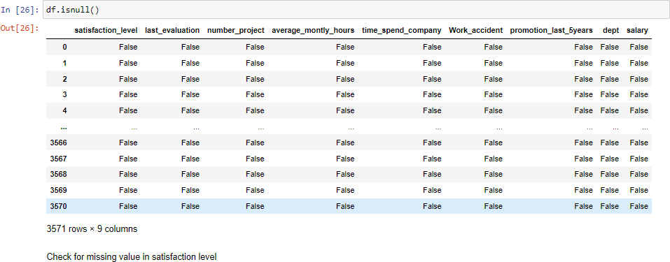
3. Data Cleaning is done by checking for null and empty values.

Slide 19
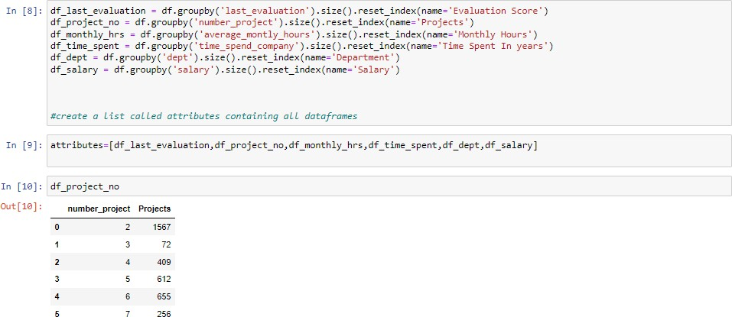
4. Data Analysis and Visualization by Checking Exiting Employees :
By Data analysis, 1567 employees have resigned due to being limited to two projects
Figure : Employee Resigning due to Number of Projects Assigned

Slide 20
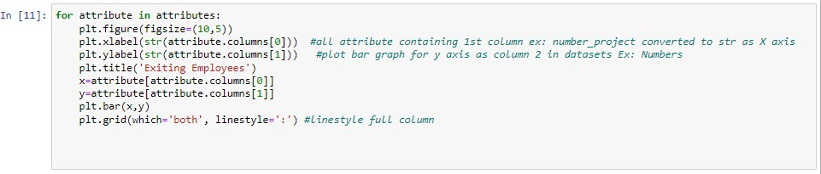
Snippet for Data Visualization Using MatPlotLib

Slide 21
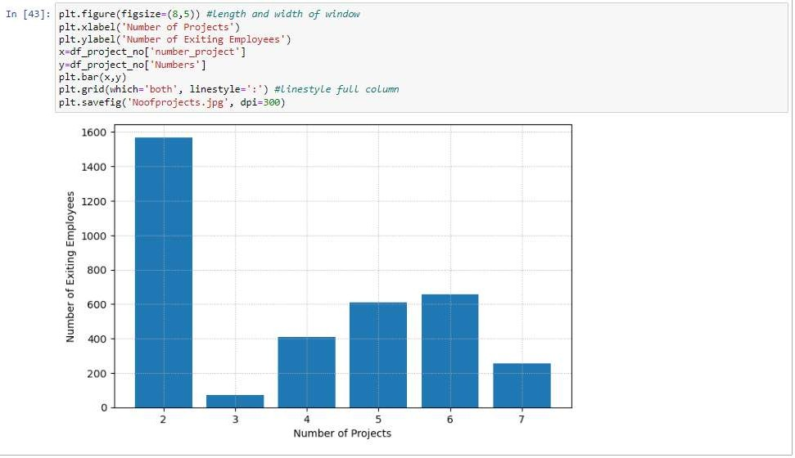
Figure : Employee Resigning due to Projects Assigned(Visualization using MatPlotLib)

Slide 22
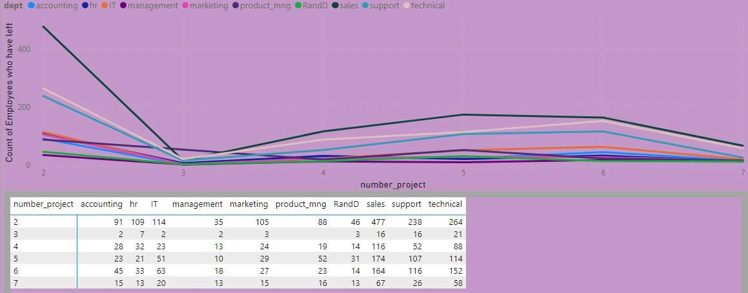
Employee Resigning due to Projects Assigned(Data Visualization using POWERBI)

Slide 23
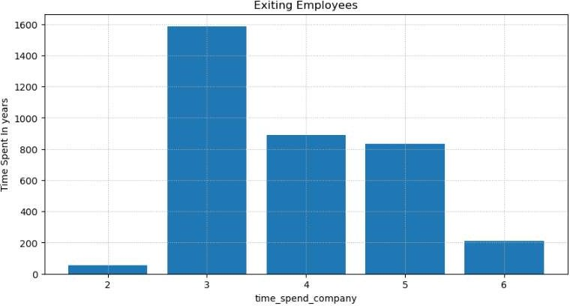
ii) By Data analysis, Most Employees who have spent 3 Years in the Company have resigned.
Figure : Employee Resigning due to Time Spent in the Company(MatPlotLib)

Slide 24
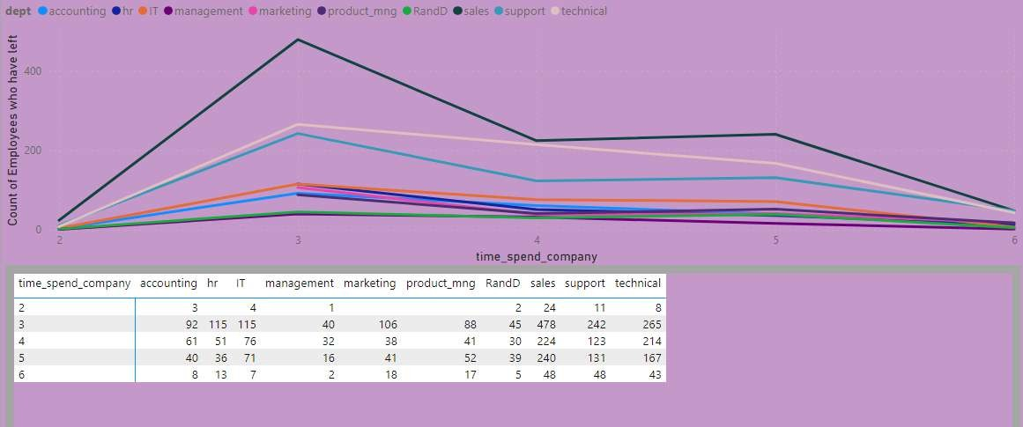
Figure : Employee Resigning due to Time Spent in the Company(PowerBI)

Slide 25
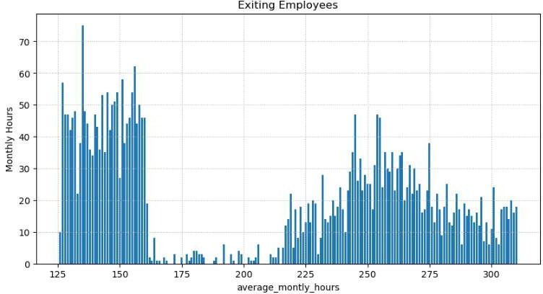
iii) By Data analysis, Most Employees who have worked an Average of 125 to 150 Hours Per Month have Resigned
Figure : Employee Resigning due to Average Monthly Hours in the Company(MatPlotLib)

Slide 26
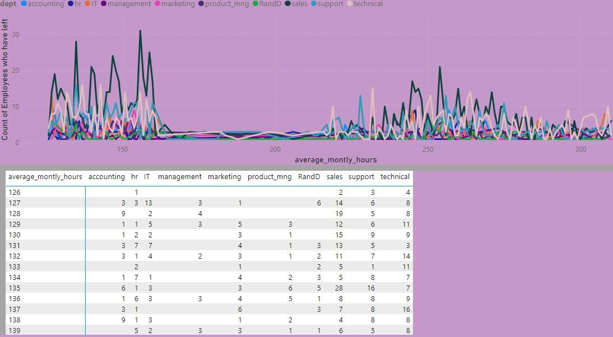
Figure : Employee Resigning due to Average Monthly Hours in the Company(PowerBI)

Slide 27
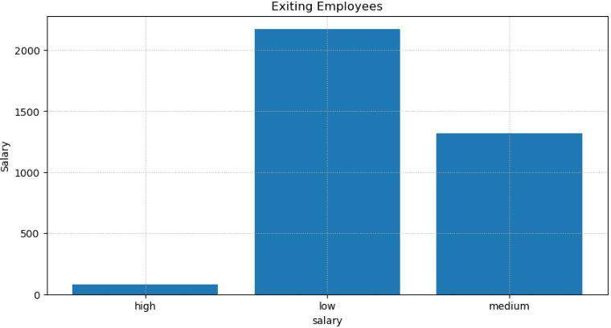
iv) By Data analysis, Most Employees with Low Salary are resigning from the company for better opportunities.
Figure: Employee Resigning due to Low Salary in the Company(MatPlotLib)

Slide 28
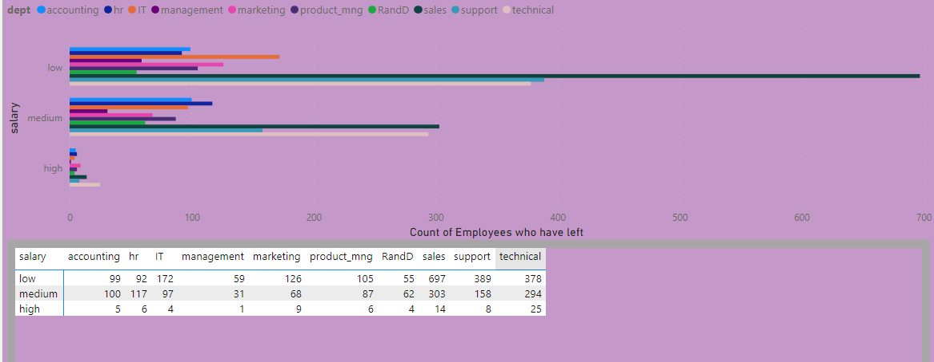
Figure: Employee Resigning due to Low Salary in the Company(PowerBI)

Slide 29
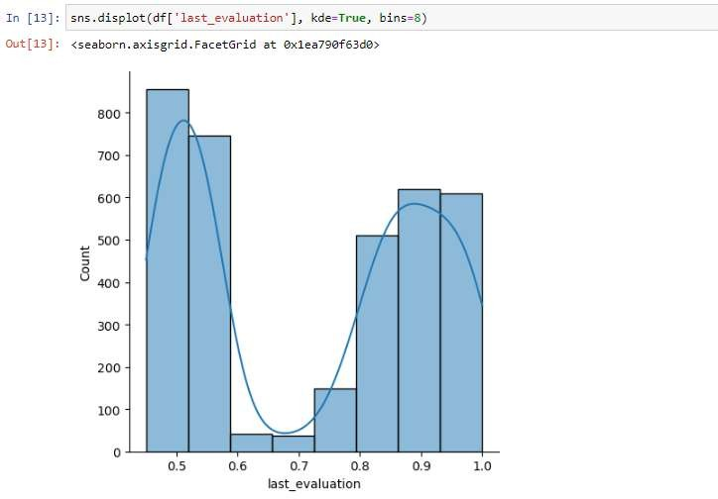
v) By Data analysis, Most Employees with Last Evaluation Score less than 0.6 out of 1 are resigning from the company.
Figure : Employee Resigning due to Low Evaluation Score in the Company(MatPlotLib)

Slide 30
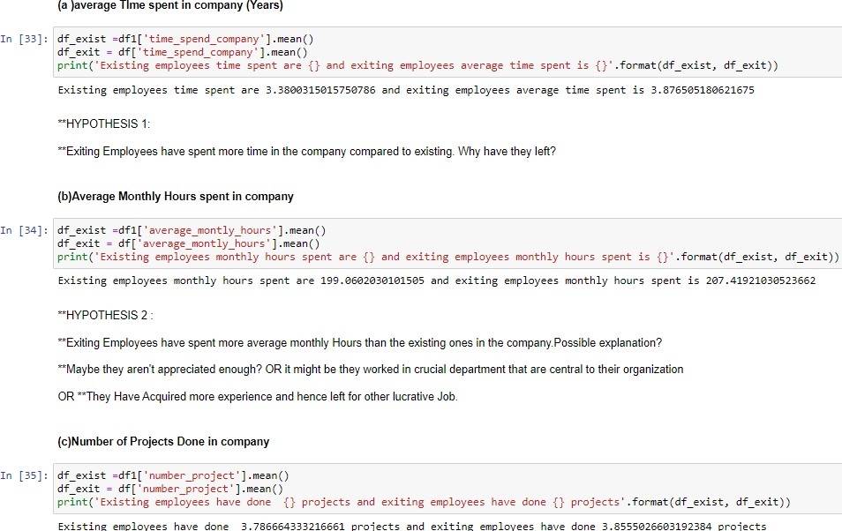
vi) By Data analysis, the Resigning Employees have worked more Average Hours/month, Spent more years and worked on more projects than the current Employees. But they have left the company due to only 19 out of 3571 receiving promotion in the company

Slide 31
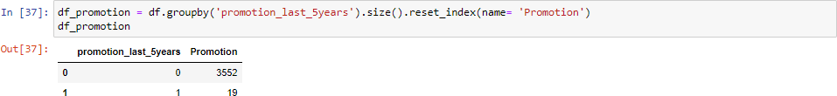
Figure: Employee Resigning due to No Promotion in the Company

Slide 32
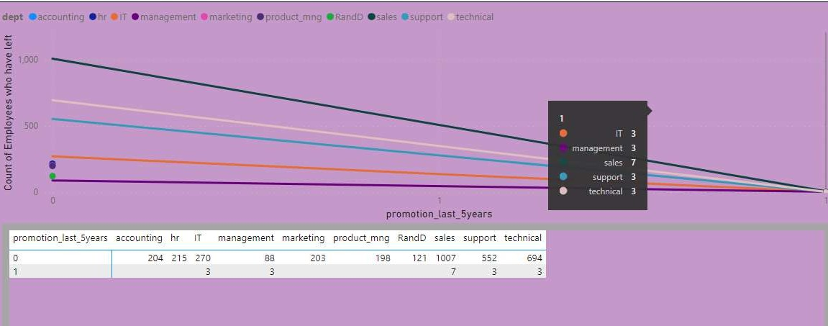
Figure: Employee Resigning due to Promotion(Power BI)

Slide 33
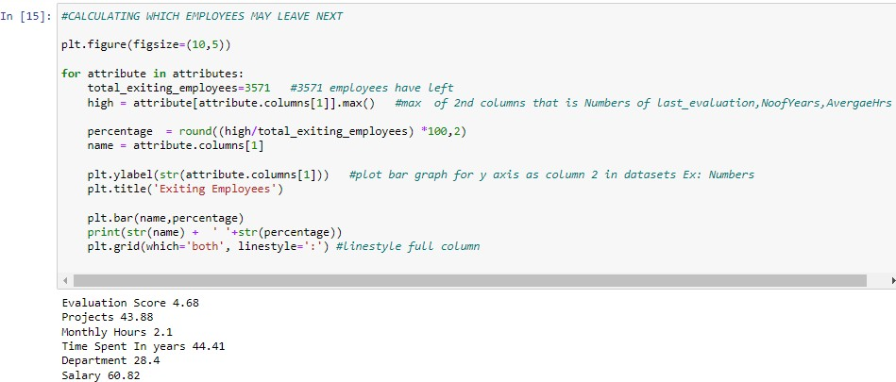
vii) Data Analysis of which type of employees may leave the company Next?
By Analysis of all the attributes, We take the maximum of all the count of employees resigned due to no of projects, total years worked, average monthly hours, salary, evaluation score, promotion and divide the value by 3571 which gives us the percentage of all employees who may leave next due to number of projects, total years worked, average monthly hours, salary, evaluation score, promotion. After analyzing we get the following results :

Slide 34
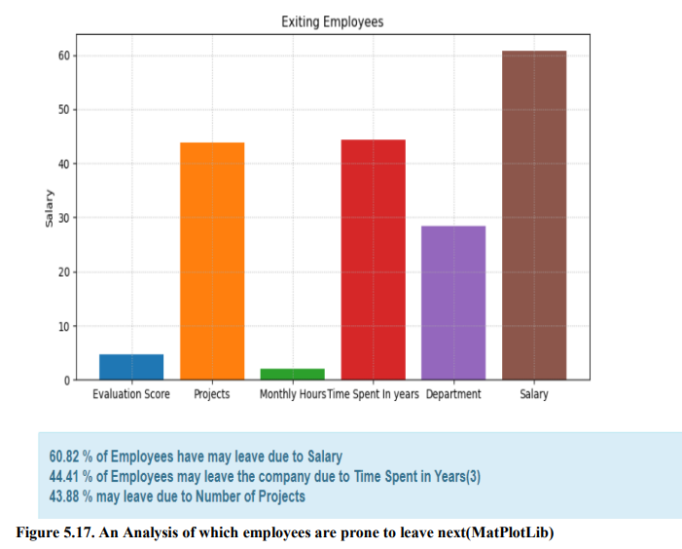

Slide 35
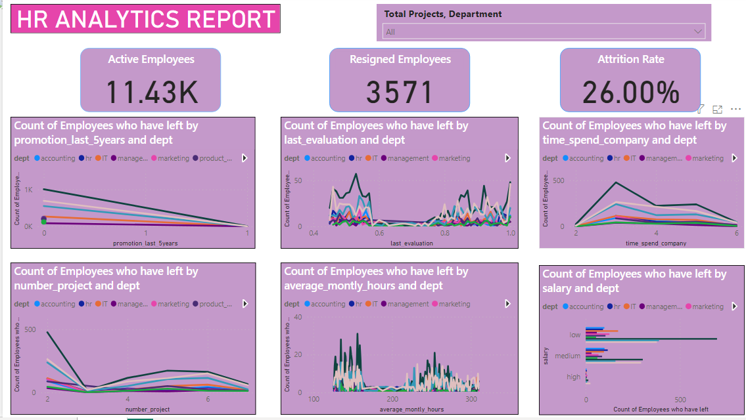
HR ANALYTICS USING POWERBI

Slide 36
CONCLUSION AND FUTURE SCOPE :
The employment landscape is expected to alter in many ways in 2023
1) Hybrid model to thrive, not just survive : The pandemic redefined work culture with rapid digital transformation. Professionals now prefer flexibility in their work, and this trend is expected to broaden its scope in the days to come.
2) Promote overall well-being: In order to attract and retain top talent, organizations must focus on creating a positive employee experience at all stages of the employment journey, including job postings to onboarding and beyond.

Slide 37
REFERENCES :
M. A. Huselid, “The Impact of Human Resource Management Practices on Turnover, Productivity, and Corporate Financial Performance,” The Academy of Management Journal, vol. 38, no. 3, pp. 635–672, 1995. [Online]. Available: https://www.jstor.org/ stable/256741
M. T. Tessema, G. Tesfom, M. A. Faircloth, M. Tesfagiorgis, and P. Teckle, “The “Great Resignation”: Causes, Consequences, and Creative HR Management Strategies,” Journal of Human Resource and Sustainability Studies, vol. 10, no. 1, pp. 161–178, Feb. 2022. [Online]. Available: https://www.scirp.org/journal/paperinformation.aspx?paperid= 116228
Staflng Organizations, Jan. 2021. [Online]. Available: https://www.mheducation.com/ highered/product/staffing-organizations-judge-kammeyer-mueller/M9781260703054. html
“Agovino, T. (2021). The Pandemic Put an End to the Five-Day, 9-to-5, In- Office Workweek. So Where Do Businesses Go from Here HR Magazine, 66, 33-39. - References - Scientific Research Publishing.” [Online]. Available: https:
//www.scirp.org/reference/referencespapers.aspx?referenceid=3204291
K. Allman, “Career matters: ‘the great resignation’ sweeping workplaces around the world.” LSJ: Law Society of NSW Journal, vol. 10, no. 81, pp. 46–47., 2021.
S. Dua and X. Du, “Data mining and machine learning in cybersecurity,” 2011.

